Slide 1

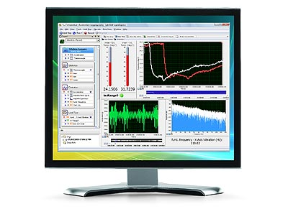

INFORMATION TECHNOLOGY INSTITUTE
MECHATRONICS 9 MONTHS PROGRAM
LabVIEW Fundamentals Course
SESSION 2
Waleed A. El-Badry
wbadry@must.edu.eg

Slide 2

Decision flow
Finite looping

Slide 3
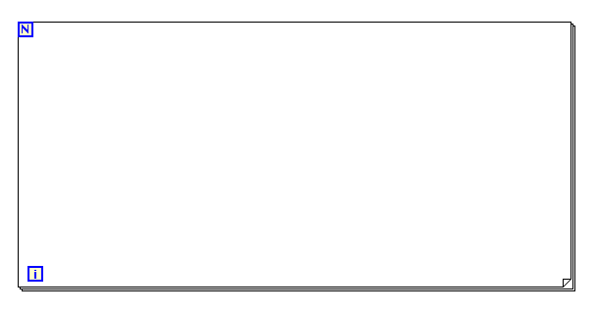
FINITE LOOPING
Number of loops
Code executed here
Current iteration number

Slide 4
Loop execution delay
Design pattern

Slide 5
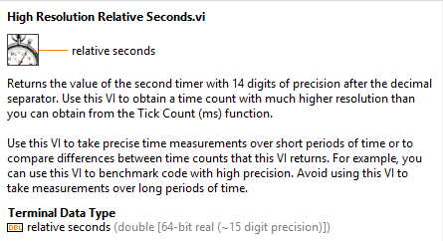

TIMING LOOPS USING TICKS

Slide 6
Exercise 1
Benchmarking time delay

Slide 7
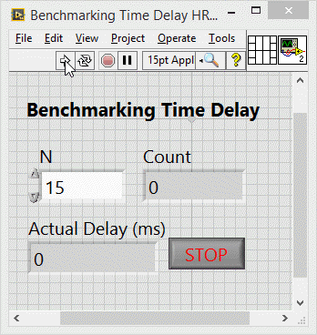
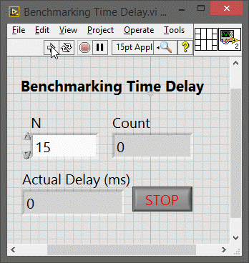
BECNCHMARKING TIME DELAY
Using Tick Count (ms)
Using High Resolution Relative Seconds

Slide 8
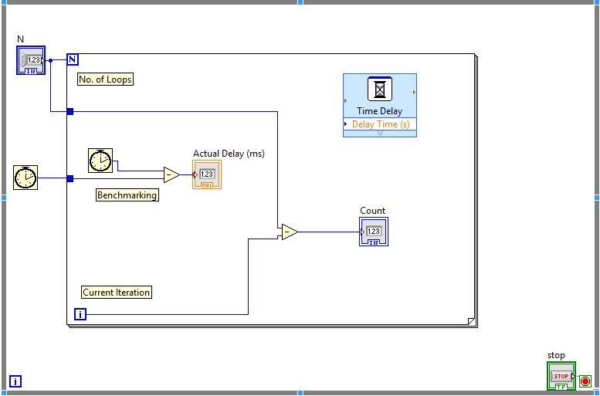
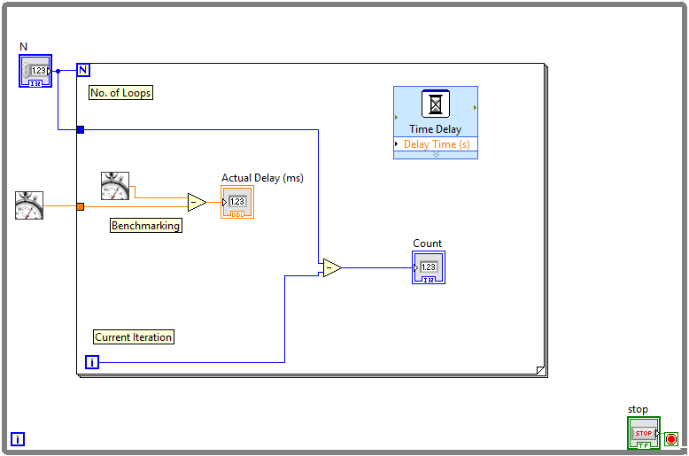
BENCHMARKING TIME DELAY
Using Tick Count (ms)
Using High Resolution Relative Seconds

Slide 9
Decision flow
BRANCHING

Slide 10
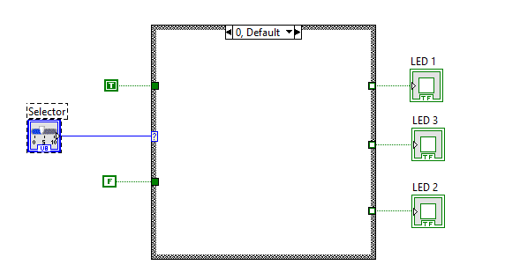
BRANCHING
Selection sub-diagram
Shared input
Selection condition
Shared output
Case Structure

Slide 11
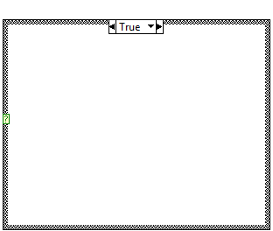
BRANCHING
Case selector could be Numeric, Boolean or String.
For numeric conditions, you can use sub-diagrams as single case or range of numbers
1..10
1-10
..10
≥10
10..
≤10
10
=10
1,4,10
=10 or =4 0r =10

Slide 12
Exercise 3
Shifting LEDS

Slide 13
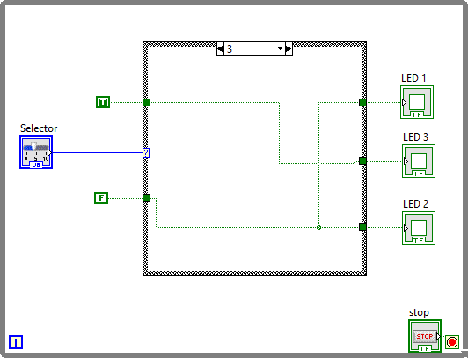
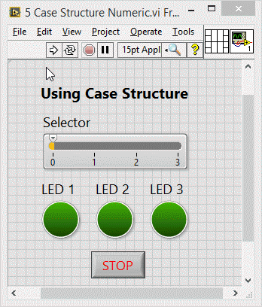
SHIFTING LEDS
LED Illumination based on slider position

Slide 14
Exercise 4
Traffic light

Slide 15
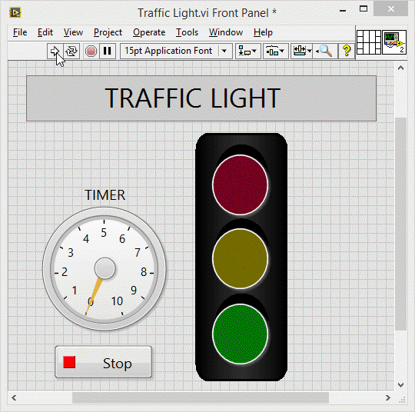
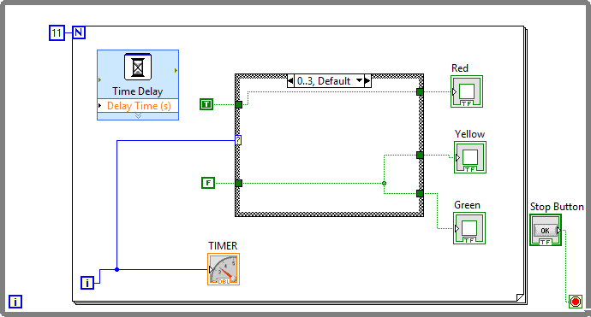
TRAFFIC LIGHT
0-3 (Red)
4-6 (Yellow)
7-10 (Green)

Slide 16
END OF SESSION 2

